Slide 1




Machine Learning Model Using regression algorithm
Bhanu Prakash Mahadevuni C0850515
Deeksha Naikap C0835440
Pramod Reddy Gurrala C0850493
Sai Varun Kollipara C0828403

Slide 2
Problem Statement
While there are different types of coronary heart disease, most individuals only learn they have the disease following symptoms such as chest pain, a heart attack, or sudden cardiac arrest.
Diagnosis tends to be driven by an initial survey of the common risk factors like high blood pressure, high blood cholesterol, followed by bloodwork and other tests.
In this study, we are trying to understand the main parameters for causing heart-attack and to build a regression model to predict the chances of attack based on the health reports.

Slide 3

Machine Learning - Regression
Regression is a machine learning technique where the model predicts the output as a continuous numerical value.
List of regression algorithms in Machine Learning:
Ridge Regression
Neural Network Regression
Lasso Regression
Decision Tree
Random Forest
XG Boost
Support Vector Machines (SVM)
Logistic Regression

Slide 4

Dataset Utilized
The dataset we have considered for this study is “Heart Disease Health Indicator”
There are 22 columns/variables and 253680 records.
https://www.kaggle.com/alexteboul/heart-disease-health-indicators-dataset

Slide 5
Model Build Requirements
Jupyter Notebook
Appropriate Python Packages
Logistic Regression
XG Boost
Light GBM
Voting Classifier

Slide 6
Steps followed for Model Building
Business Understanding
Data Collecting
Data Understanding
Data Preprocessing
Model Building
Machine Learning Predection

Slide 7
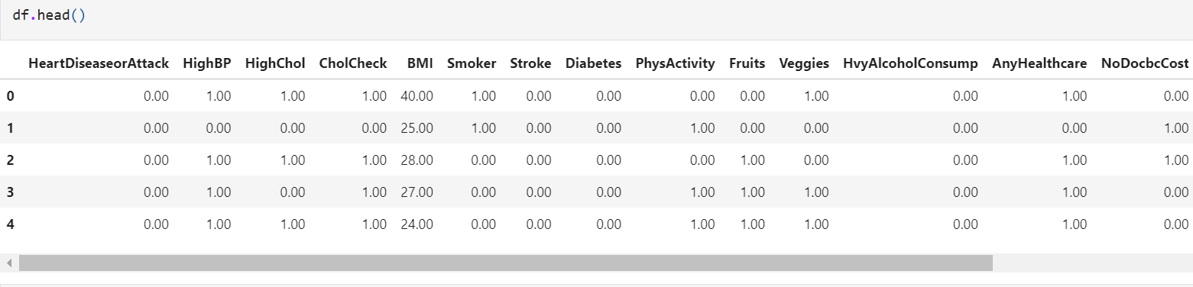
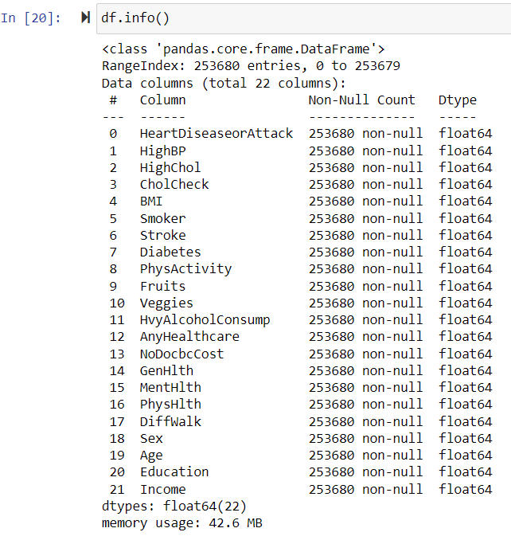
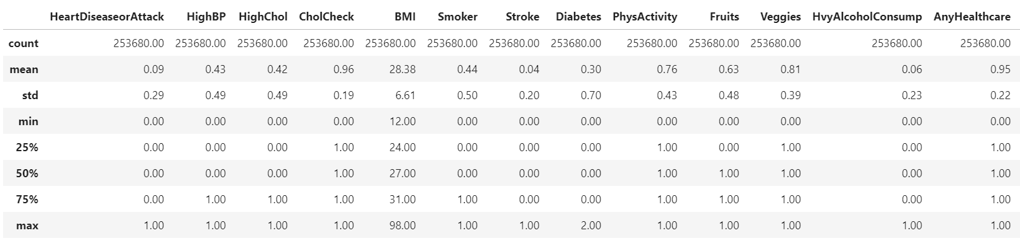
Data Understanding

Slide 8
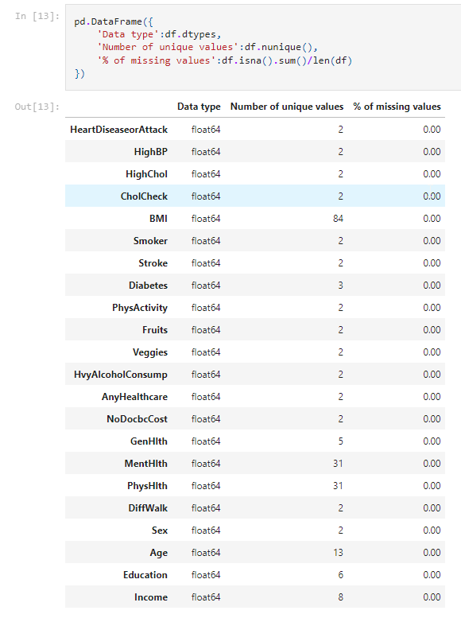
Data Preprocessing
There are no null vales in this dataset.
We have printed the columns with values greater than 10 unique values and the columns with categorical values.

Slide 9
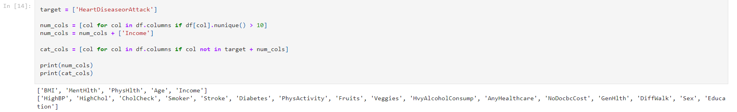
Data Preprocessing – Feature Evaluation

Slide 10
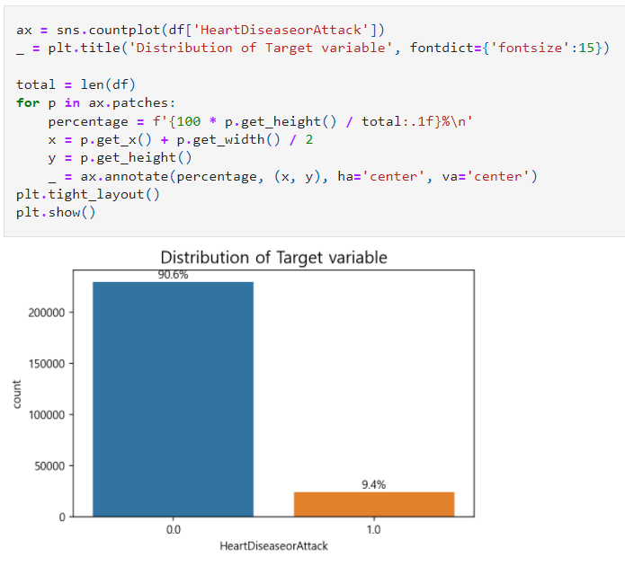
Data Visualization
Here we have 9.4% of the total records with heart disease and remaining 90.6% records with no heart problem

Slide 11

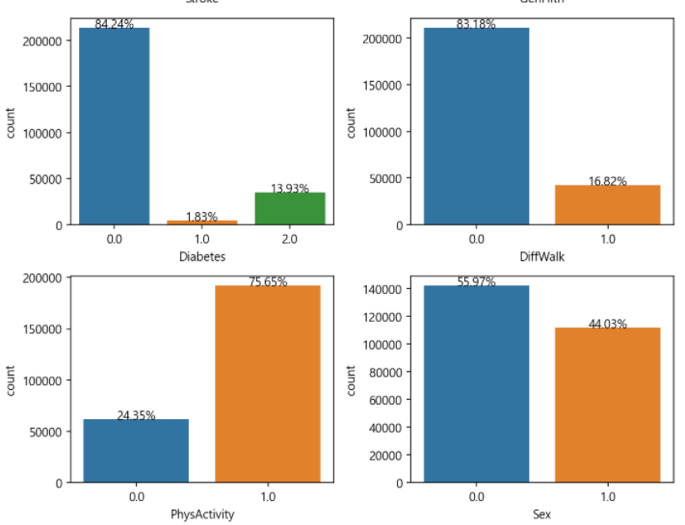
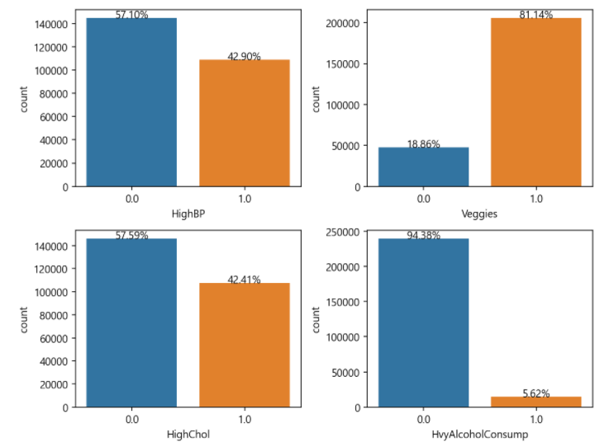
Feature based Data Visualization

Slide 12
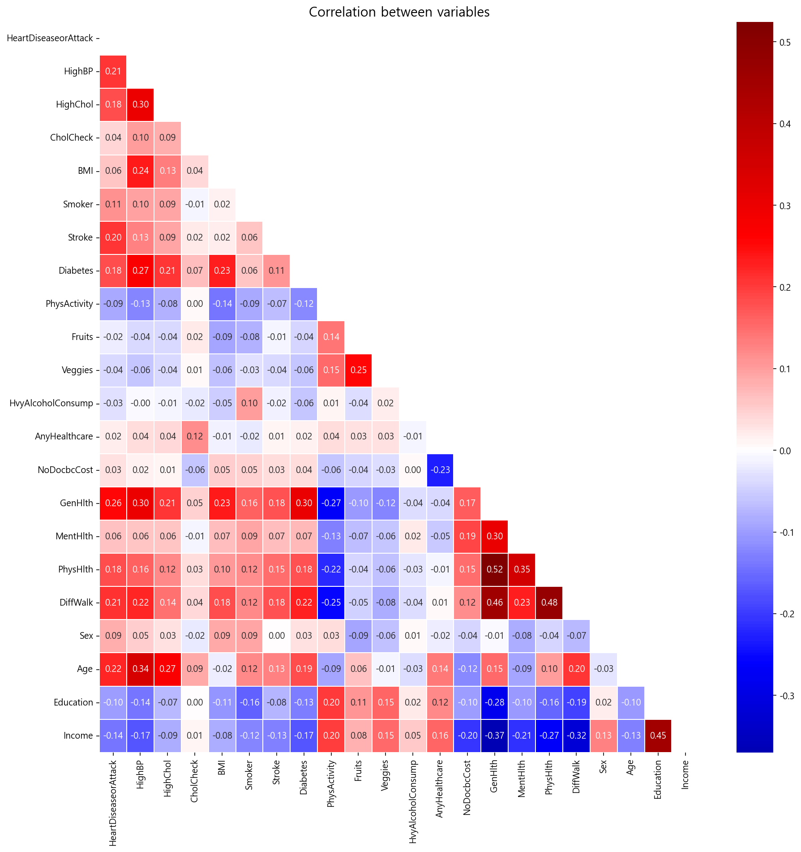
Correlation Matrix

Slide 13
Model Building Steps
Data Splitting
Data Fitting / Model Training
Evaluation Metrics for model
Model Selection
Prediction Model Building

Slide 14
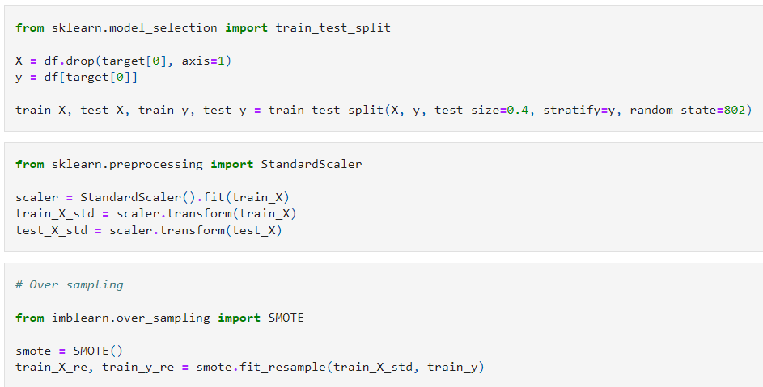
Data Splitting

Slide 15
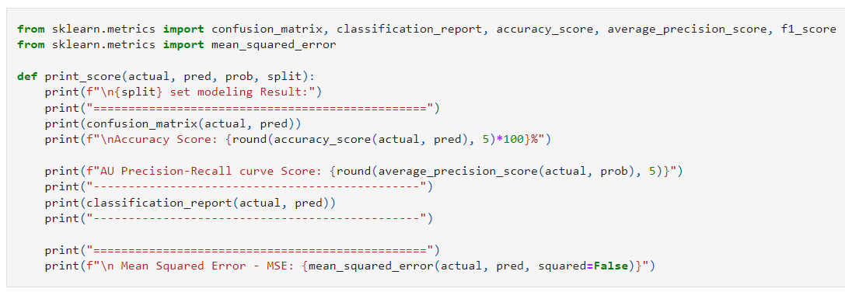
Evaluation Metrics Calculation

Slide 16
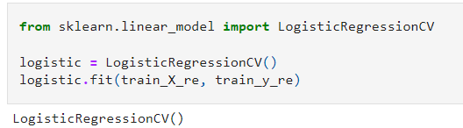
Model 1 -Logistic Regression
Logistic regression is a supervised learning algorithm used to predict a dependent categorical target variable.

Slide 17
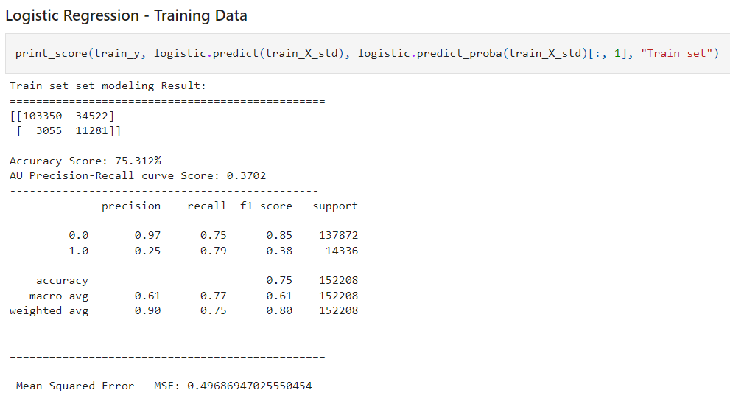
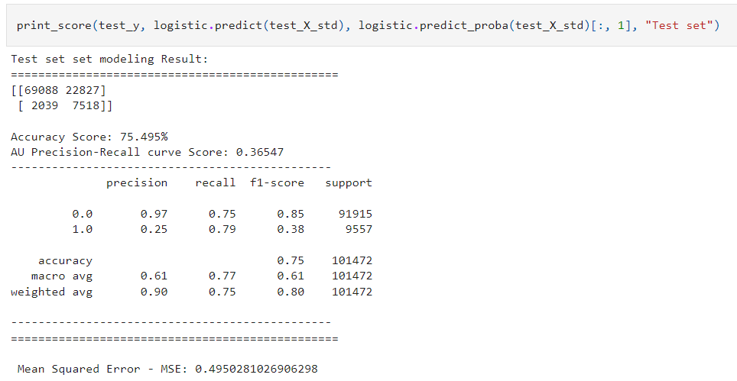
Model 1 - Results

Slide 18
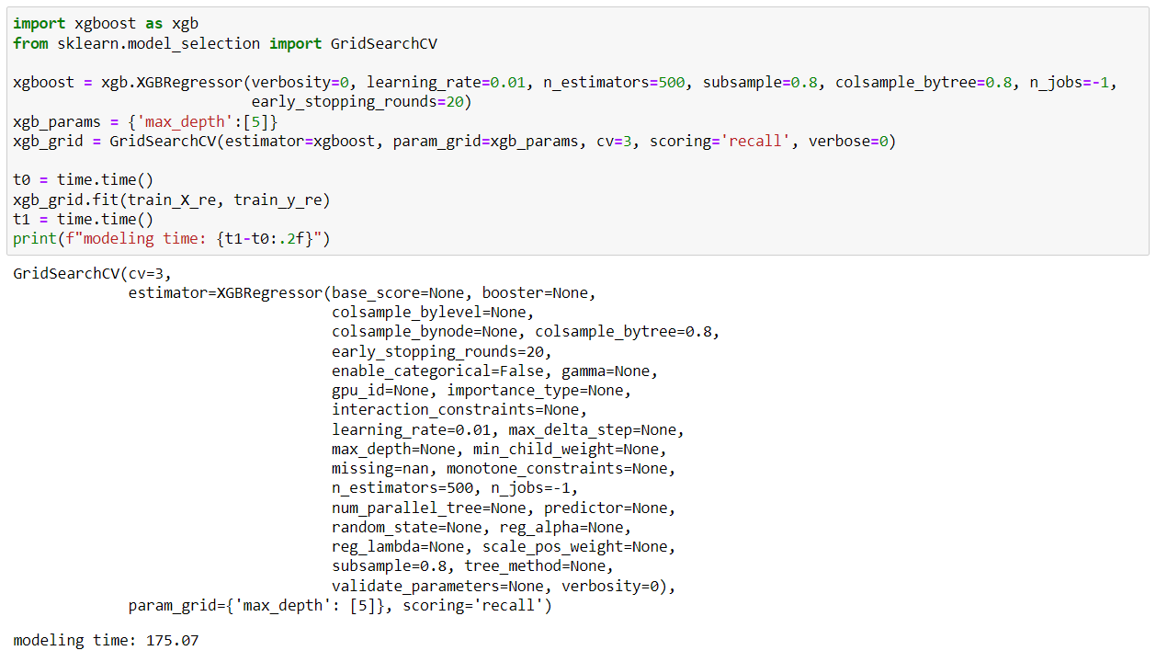
Model 2 – XG Boost
XG Boost, which stands for Extreme Gradient Boosting, is a scalable, distributed gradient-boosted decision tree (GBDT) machine learning library.

Slide 19
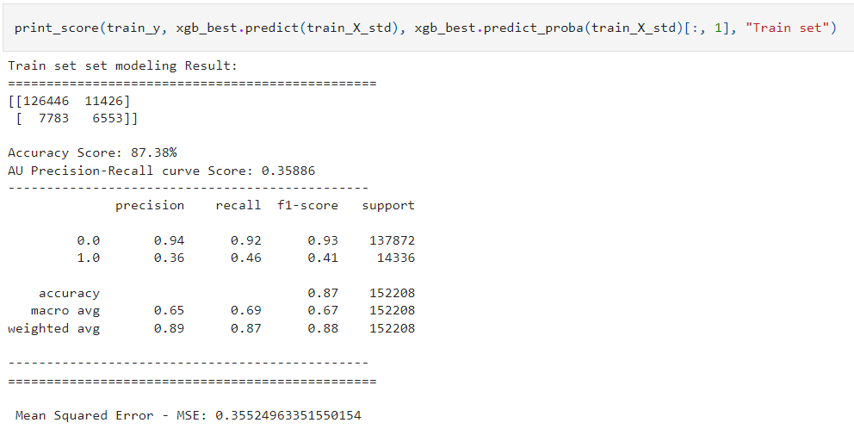
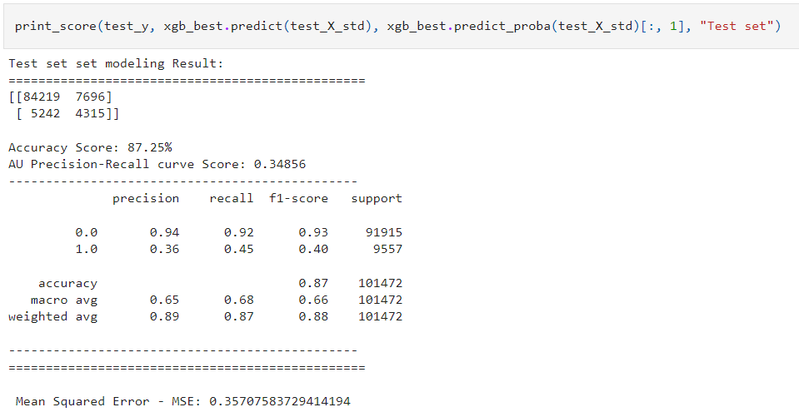
Model 2 - Results

Slide 20
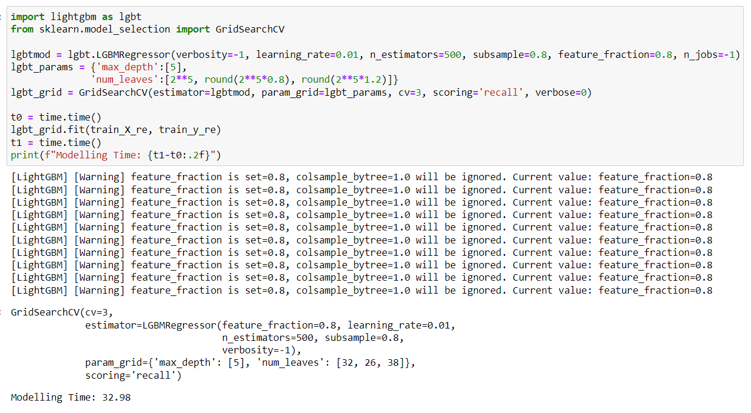
Model 3 – Light GBM
Light GBM is a gradient boosting framework that uses tree-based learning algorithms. It is designed to be distributed and efficient.

Slide 21
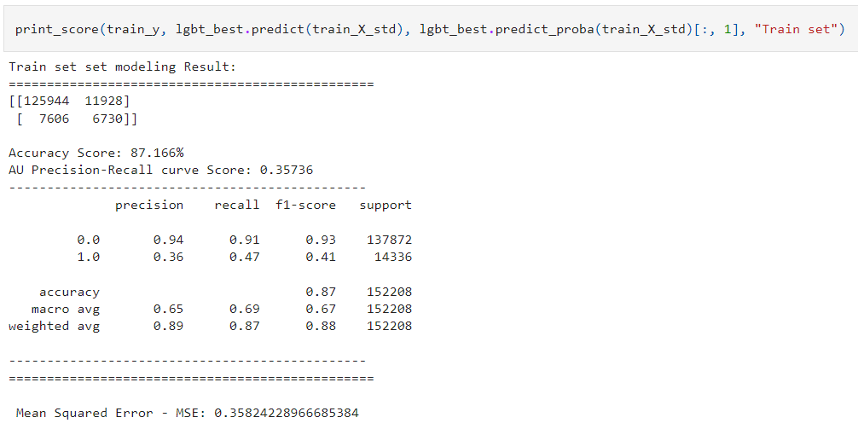
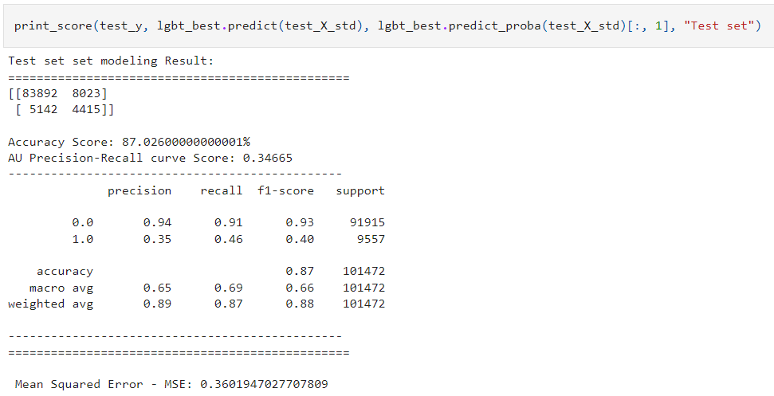
Model 3 - Results

Slide 22
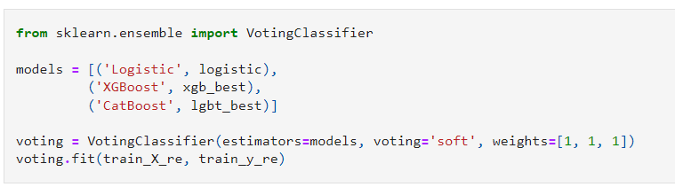
Voting Classifier
An algorithm that helps in combining the results and understanding of multiple algorithms.

Slide 23
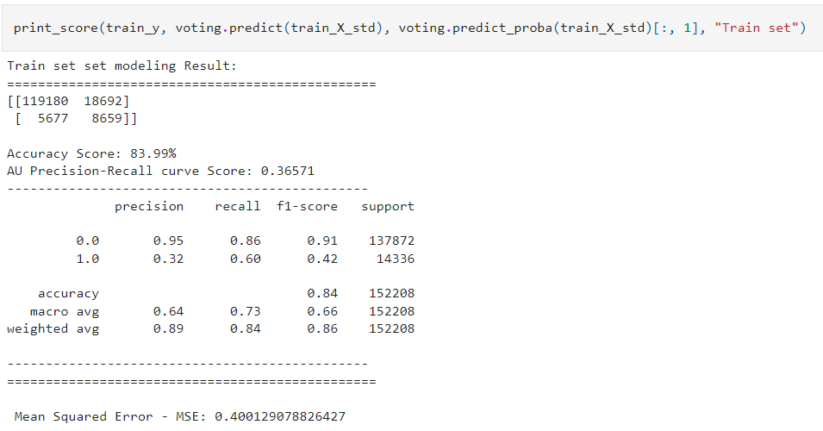
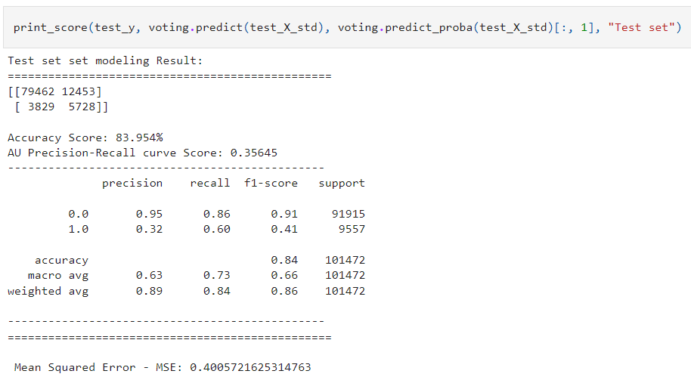
Voting Classifier - Results

Slide 24
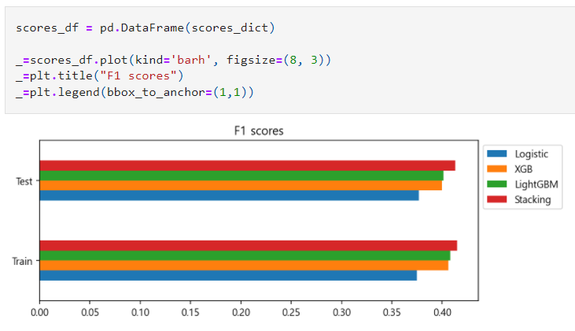
Model Comparison

Slide 25
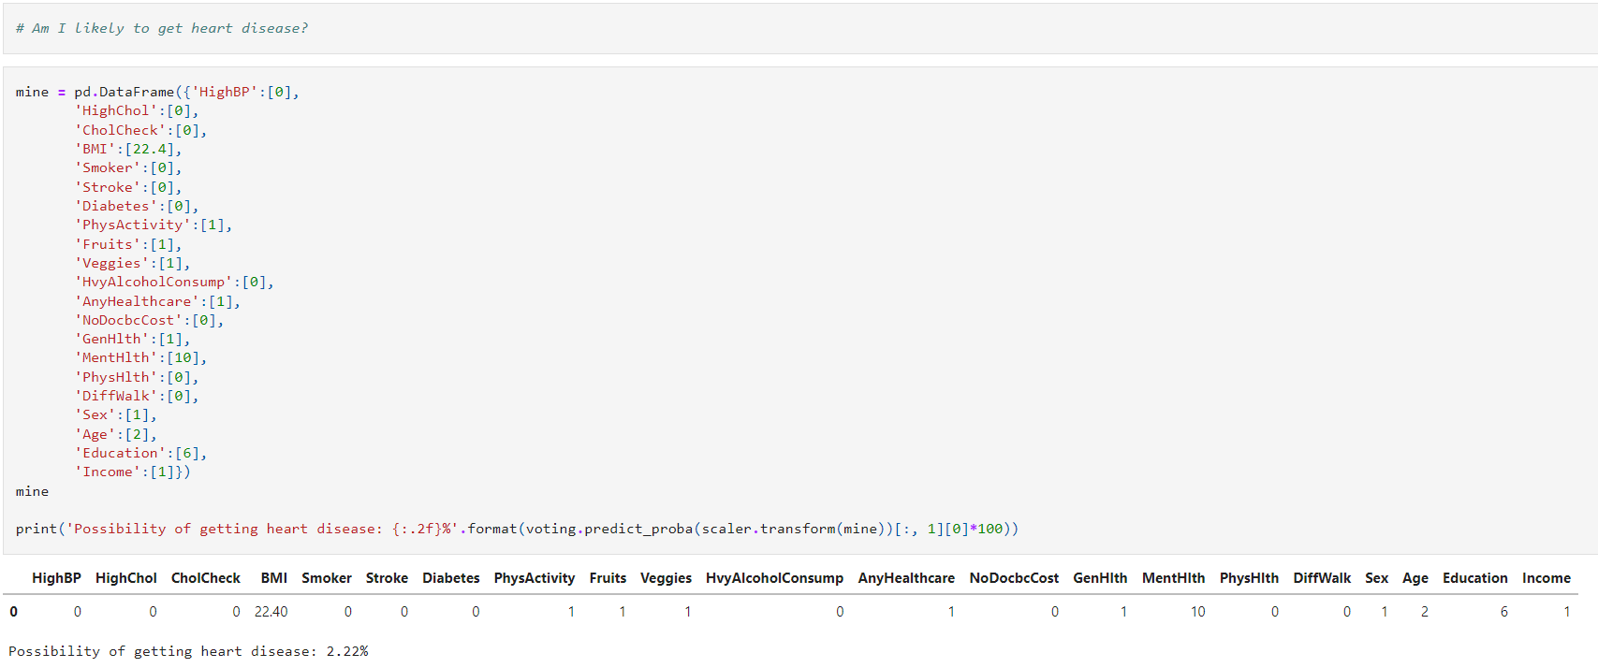
Real-Time Prediction

Slide 26
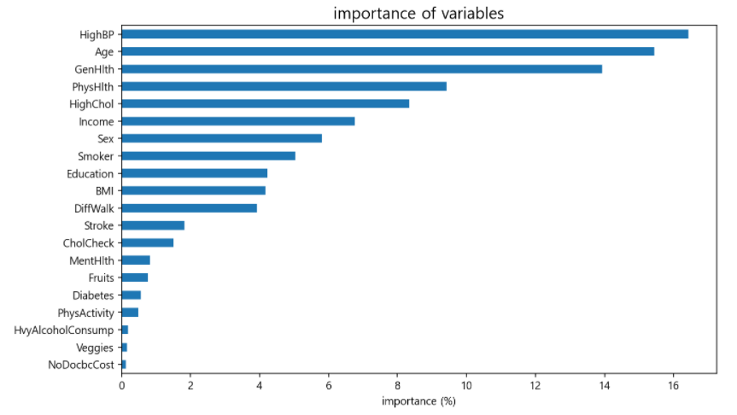
Additional Results

Slide 27
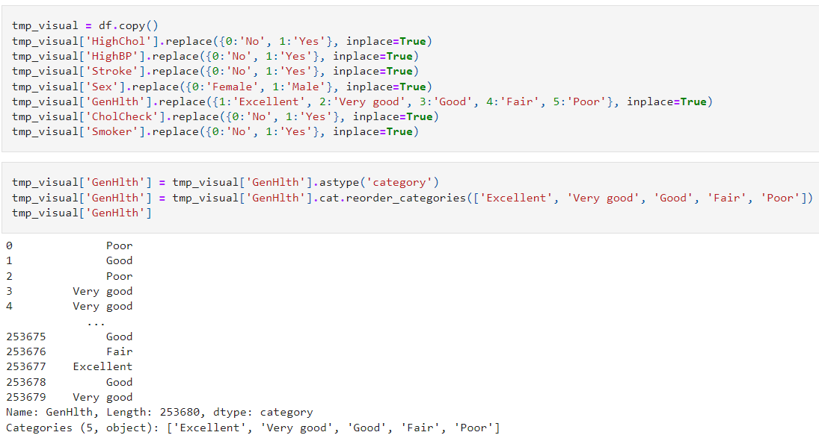
Additional Results

Slide 28
Conclusion
We have understood the behavior of the data by concentrating on specific features.
We have identified some algorithms that are working and combined them for better results.
We have created a prediction function that can take the patients information and calculate the changes of heart diseases.
We have also implemented the function on entire dataset to check their condition.

Slide 29
Big Data 5V’s
Volume – The Size of the dataset is 22*253680
Value – The value is immensely high due to the performance and applications of the model
Variety – Singular data-type of information, but the from multiple domains like body conditions, daily activities, hobbies and so on.
Veracity – The dataset having no null based data.
Velocity – The current dataset is having some limitations, but with continuous information of patients the dataset can be vast.

Slide 30
Thank You

